Slide 1
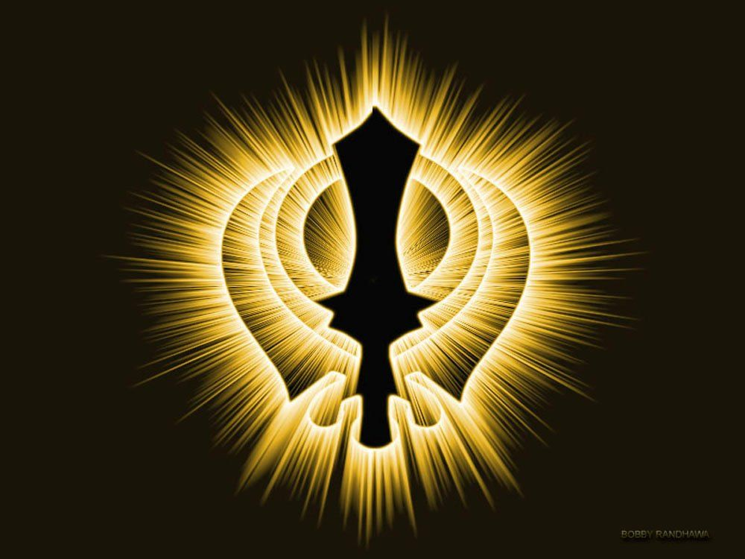
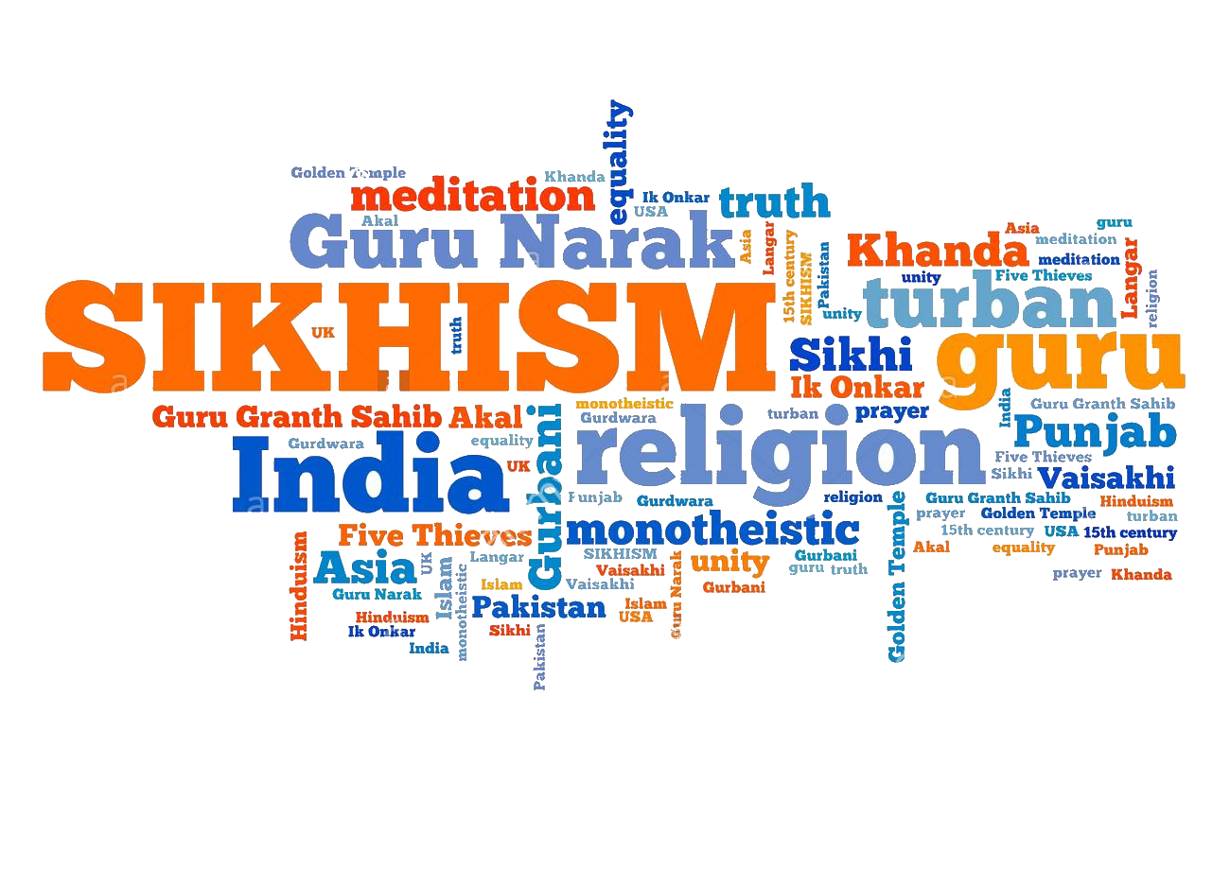

MY CULTURE…
SIKHISM

Slide 2
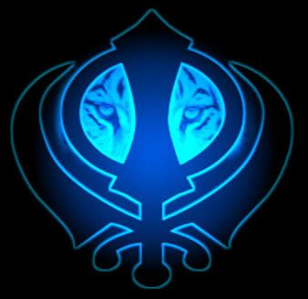
THERE ARE MANY CULTURAL ACTIVITIES IN SIKHISM

Slide 3
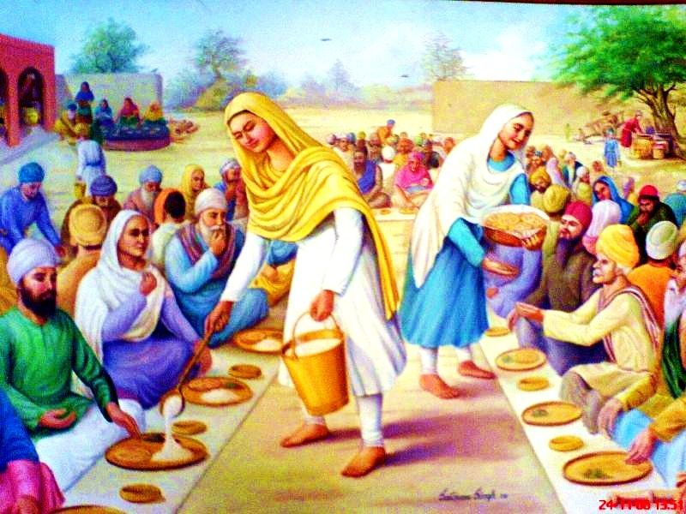
LANGAR
ABOUT
Langar term used in Sikhism for the community kitchen in a Gurdwara where a free meal is served to all the visitors, without distinction of religion, caste, gender or economic status.

Slide 4
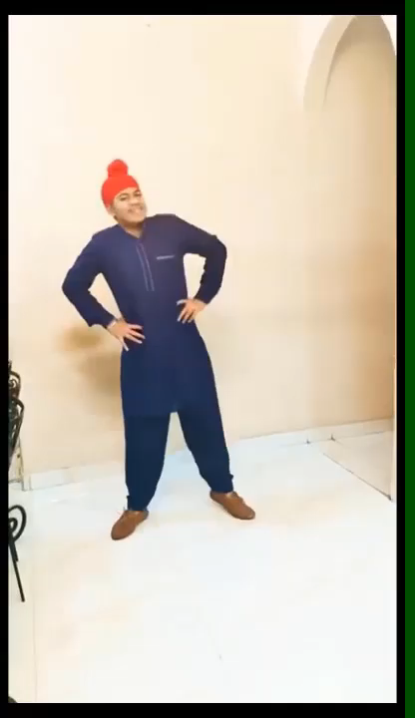
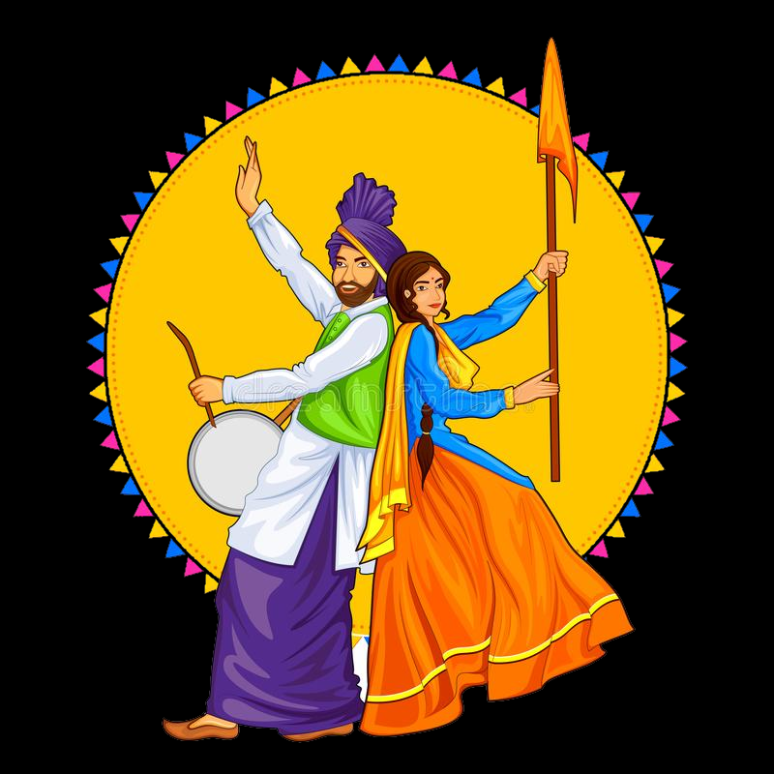
BHANGRA
ABOUT
Bhangra refers to several forms of folk dance and music that originate in the Punjab region of India. Bhangra has a very energetic and lively tone and the dance is equally vivacious.

Slide 5
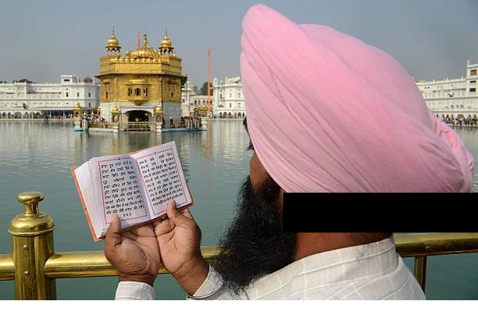
SIKH PRAYER
(PATH)
ABOUT
Path, from the Sanskrit patha which means reading or recitation, is, in the religious context, reading or recitation of the holy texts. In Sikhism, it implies daily repetition of scriptural texts from the Guru Granth Sahib..
PATH

Slide 6
THERE ARE MANY FESTIVALS IN SIKHISM

Slide 7
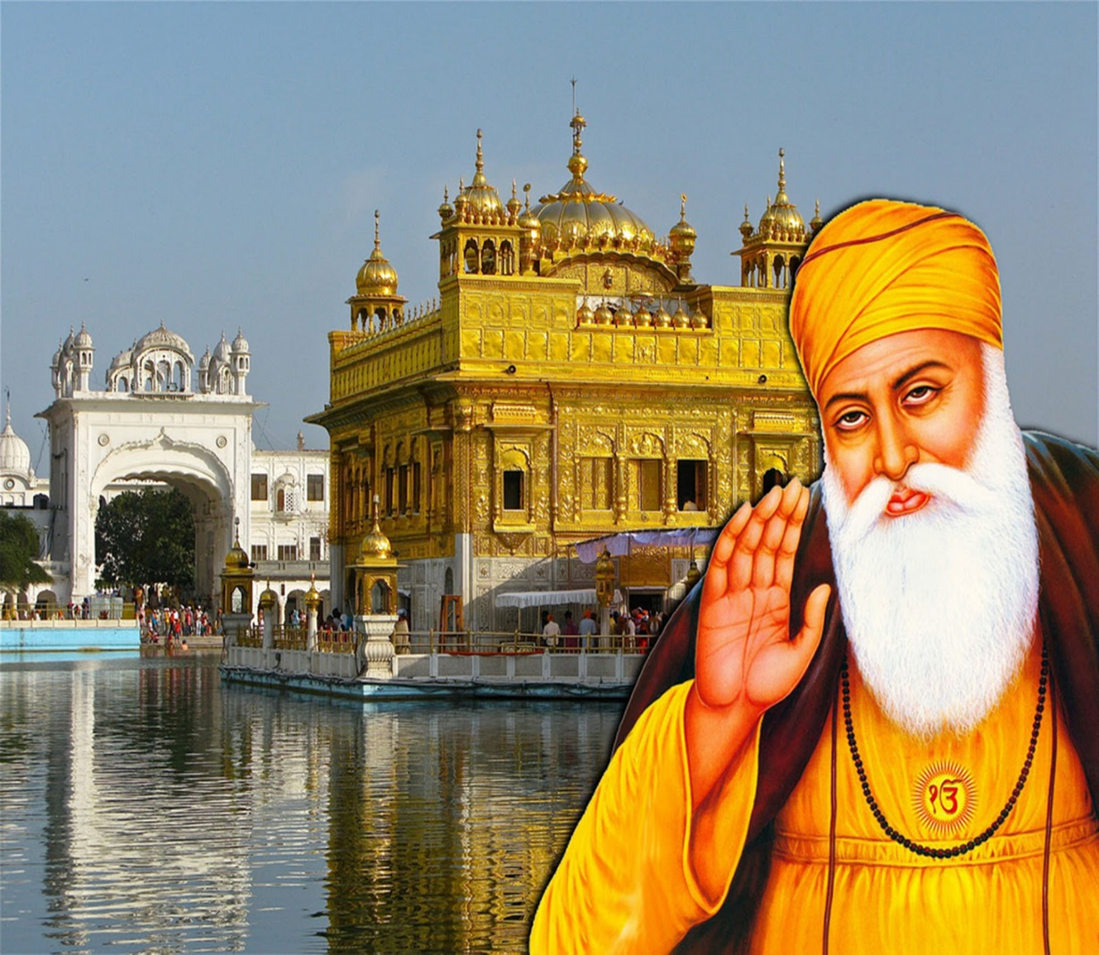
GURU NANK
JAYANTI
ABOUT
Guru Nanak Jayanti, the foremost of all the Gurupurabs or anniversaries of the 10 Sikh Gurus, is the birth anniversary of Guru Nanak Dev Ji, the founder of the Sikh faith. The first of the 10 Sikh Gurus, Guru Nanak Ji was born in 1469 at Talwandi, near Lahore.

Slide 8
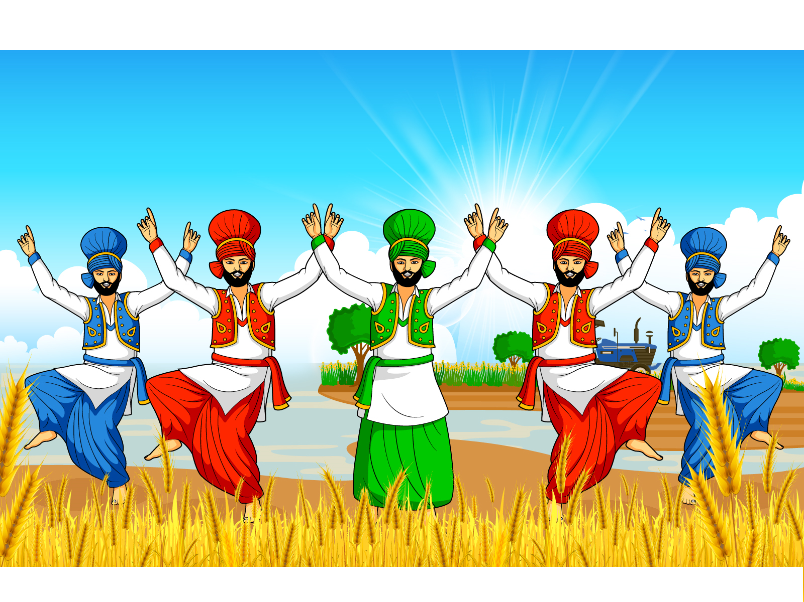
BAISAKHI
ABOUT
Baisakhi is a spring harvest festival which is celebrated on April 13 or 14 every year. It marks the Sikh new year and commemorates the formation of Khalsa panth of warriors under Guru Gobind Singh in 1699.

Slide 9
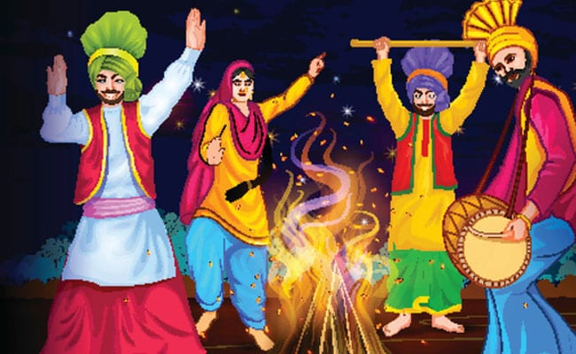
LOHRI
ABOUT
Lohri is a popular winter Punjabi folk festival, celebrated on 10 January every year. The significance and legends about the Lohri festival are may and these link the festival to Punjab region

Slide 10
THANK
YOU
-BY HARMEET SINGH

